Slide 1
Twitter Sentiment Analysis
By
Mohit (U33745431)
Vijay(U13429935)

Slide 2
What is Sentiment Analysis?
Sentiment analysis is also known as Opinion mining.
Determining good, bad and neutral.
We are analysing twitter data as part of this project.

Slide 3
Why Twitter data?
Huge social platform with large user base.
Tweets related to person, products etc…almost everything.
Benefits
To get business insights of a company.
To get know customer reviews about any product.
To know what public think about any particular topic.

Slide 4
Determining Racist/Non-racist tweets
Dataset columns - id, label, tweet
Label 1 - Racist tweets, Label 0 - Non- Racist tweets
Processing tweet text - (using regex and nltk module)
Removal hyperlinks and special characters.
Removal of stopwords (eg:- a, an, the and other prepositions).
Stemming words (Reducing a word to its stem, eg:- playing, played,plays to play).
Calculation of most frequently occuring words.
Extracting hashtags in the tweet.
Model training.
Model Evaluation.

Slide 5
Data transformation Facts
The raw tweets resulted into approximately 4.5 lakhs words.
After processing the data by removing stopwords, we left with approximately 2.16 lakhs words.
After applying stemming on the dataset words, we are choosing most frequent occurring 500 words.
We are taking most frequent 500 words and merging this data with most frequent hashtags.
We are considering Hashtags and fetching 25 most frequent positive hashtags and 500 most frequent negative hashtags.
We are focusing more on negative hashtags since the dataset contains less negative tweets.
Then we are creating dummies using the combination of most frequent hashtags and words.

Slide 6
Building Model
We are splitting the train dataset into 80:20 ratio for train and test.
Logistic Regression
Accuracy is 96%.
The confusion matrix is : [ [5929 34] [ 228 202] ].
Naive Bayes (Multinomial)
Accuracy is 95%.
The confusion matrix is : [ [5929 34] [ 228 202] ].

Slide 7
Python Libraries Used
pandas
numpy
re (Regular expression)
tweepy
textblob
dash
core, html and dependency components.
Plotly
graph_objs
Nltk (Natural Language Toolkit)
Stem, corpus
sklearn

Slide 8
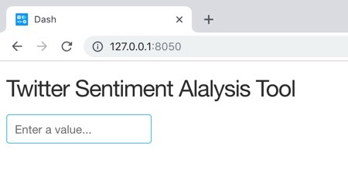
Analysis on Live Twitter data

Slide 9
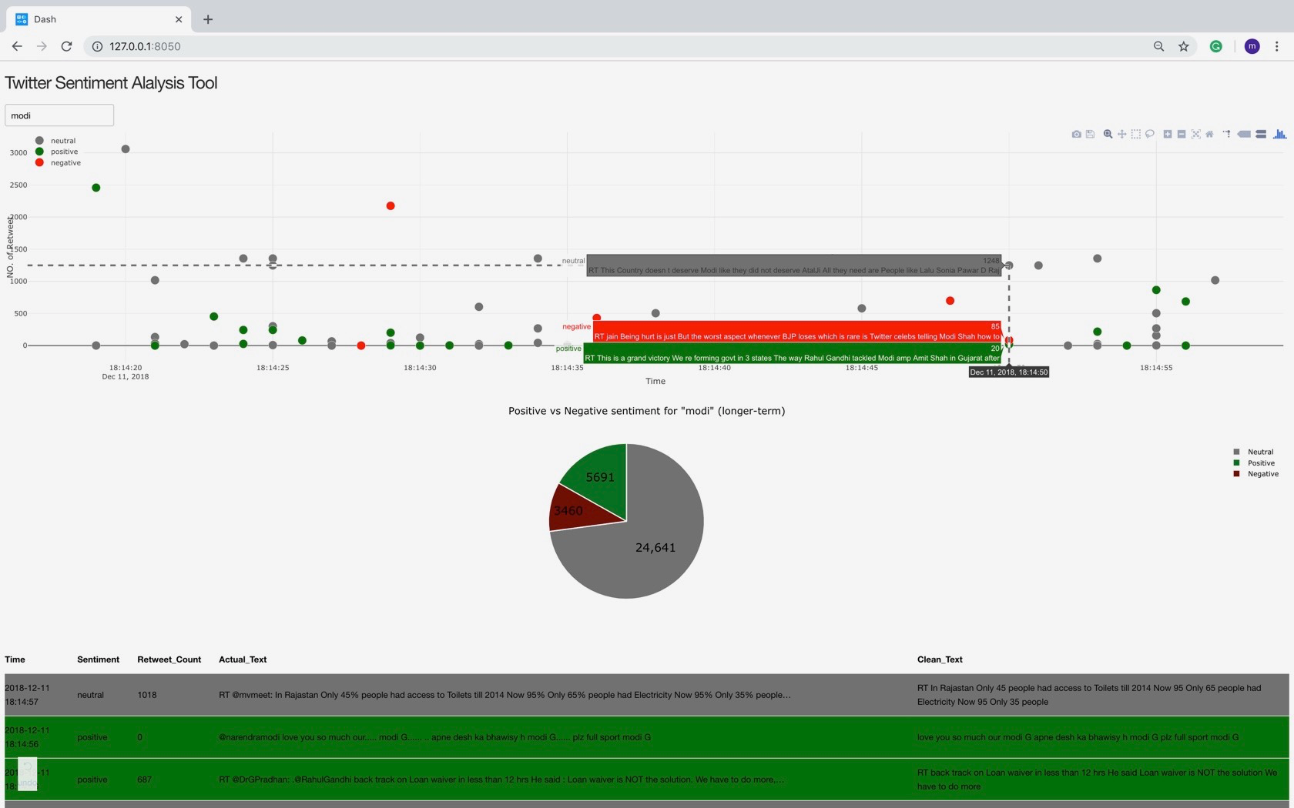

Slide 10
Difficult Part and how the model can be improved?
The most difficult part was deciding how we are going to choose the words to make the dummy dataset so that the chosen words represent the best possible sentiment.
If we had more time we could have included duplets and triplets word combination and some other technique to train the model so that we can achieve more accuracy.
Video Link :- https://youtu.be/bbMwSfIPcmw

Slide 11
Thank You

